Slide 1
Strategic Highway Safety Plan Meeting
SAFE SYSTEMS APPROACH
March 22, 2024
Joe Moges

Slide 2

Safe System Approach
What is a Safe System Approach?
Principles:
  Death and Serious Injuries are Unacceptable
  Humans Make Mistakes
  Humans are Vulnerable
  Responsibility is Shared
  Safety is Proactive
  Redundancy is Crucial
Objectives
  Safer People
  Safer Roads
  Safer Vehicles
  Safer Speeds
  Post-Crash Care

Slide 3
What Is a Safe System Approach?
Building and reinforcing multiple layers of protection to both prevent crashes from happening in the first place and minimize the harm caused to those involved when crashes do occur.
Holistic and comprehensive approach that provides a guiding framework.
Human mistakes AND human vulnerability.

Slide 4

BACKGROUND
Maryland is a Vision Zero State
Impacts of traffic-related fatalities and serious injuries are disproportionately felt by vulnerable road users such as pedestrians and cyclists.

Slide 5
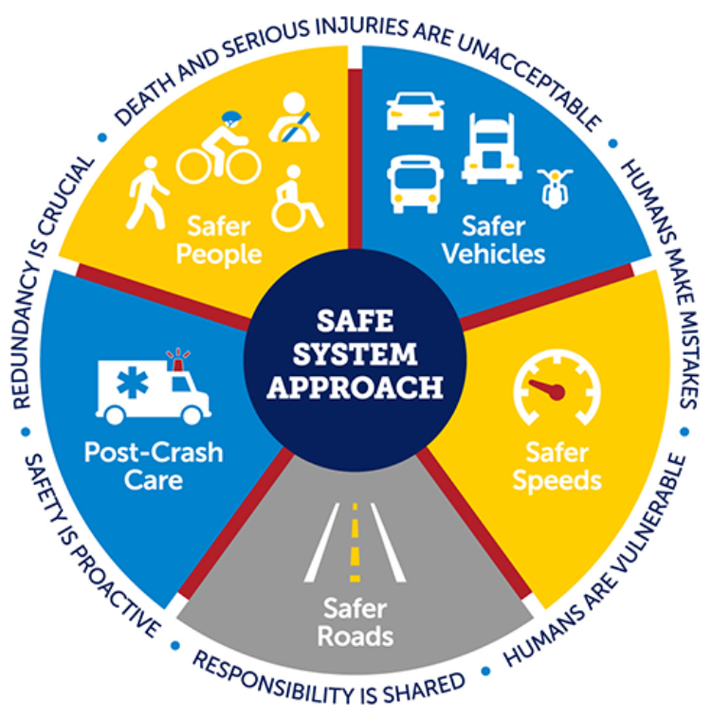
Principles
Death and Serious Injuries are Unacceptable
Humans Make Mistakes
Humans are Vulnerable
Responsibility is Shared
Safety is Proactive
Redundancy is Crucial

Slide 6

Principles
Death and Serious Injuries are Unacceptable
  A Safe System Approach prioritizes the elimination of crashes that result in death and serious injuries.

Slide 7
Principles
Humans Make Mistakes
People will inevitably make mistakes and decisions that can lead or contribute to crashes.

Slide 8

Principles
Humans are Vulnerable
Human bodies have physical limits for tolerating crash forces before death or serious injury occurs.

Slide 9

Principles
Responsibility is Shared
All stakeholders are vital to preventing fatalities and serious injuries on our roadways.

Slide 10

Principles
Safety is Proactive
Proactive tools should be used to identify and address safety issues in the transportation system, rather than waiting for crashes to occur and reacting afterwards.

Slide 11
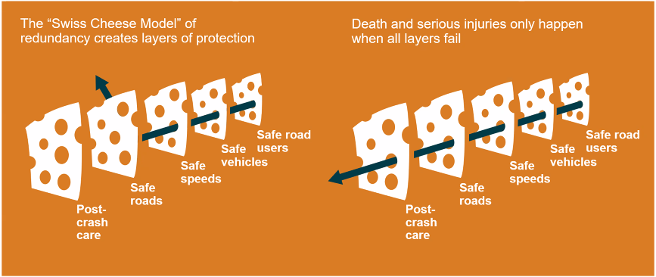
Principles
Redundancy is Crucial
Reducing risks requires that all parts of the transportation system be strengthened, so that if one part fails, the other parts still protect people.

Slide 12
objectives
Safer People
Safer Roads
Safer Vehicles
Safer Speeds
Post-Crash Care

Slide 13
Objectives
Safer People
Encourage safe, responsible driving and behavior by people who use our roads and create conditions that prioritize their ability to reach their destination unharmed.
Behavioral Safety Factors
  People in motor vehicles not wearing seat belts
  Driving while impaired from alcohol
  Speeding

Slide 14

Objectives
Safer vehicles
Expand the availability of vehicle systems and features that help to prevent crashes and minimize the impact of crashes on both occupants and non-occupants.

Slide 15
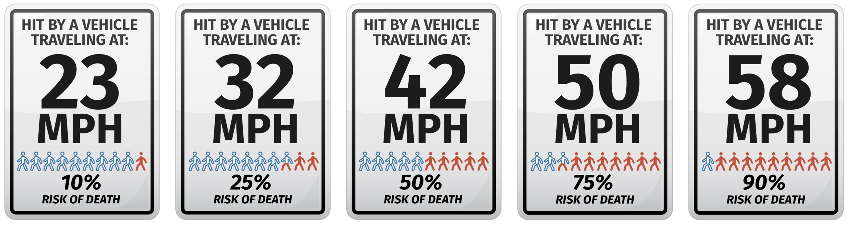
Objectives
Safer speeds
Promote safer speeds in all roadway environments through a combination of thoughtful, equitable, context-appropriate roadway design, targeted education, outreach campaigns, and enforcement
Impact Speed and a Pedestrian’s Risk of Death

Slide 16




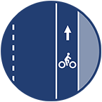

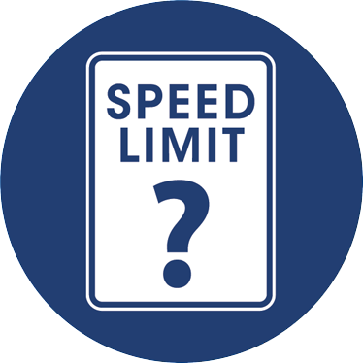
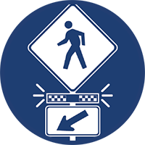

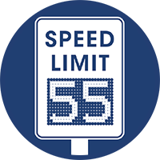








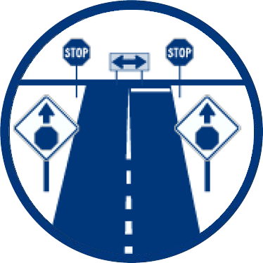
Objectives
Safer roads
Design roadway environments to mitigate human mistakes and account for injury tolerances, to encourage safer behaviors, and to facilitate safe travel by the most vulnerable users.

Slide 17
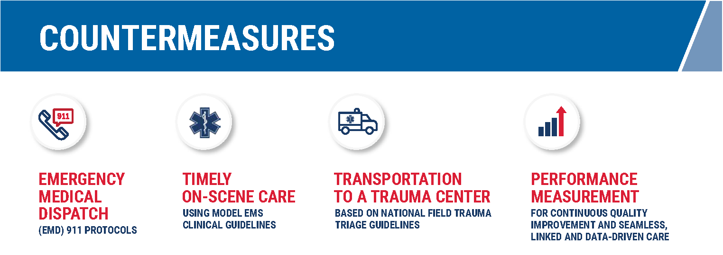
Objectives
Post-Crash Care
Enhance the survivability of crashes through expedient access to emergency medical care, while creating a safe working environment for vital first responders and preventing secondary crashes through robust traffic incident management practices.
Access to Emergency and Trauma Care Is Critical to the Survivability of Crashes

Slide 18
Safe System Approach
SHA and our partners have been working to incorporate its principles for the past several years.
“Safer roads” is one objective of the Safe System Approach which directs practitioners to, “design roadway environments to mitigate human mistakes
Complete Streets initiatives, implementing proven countermeasures, and developing guidance to promote road designs and construction methods that facilitate safer travel.
SHA’s Context Driven initiative
In 2020 SHA announced our Context Driven Guide
MDOT’s Consolidated Transportation Program

