Slide 1
MD 2026-2030 SHSP Development

Slide 2
Who is Crash Core?
Crash Center for Research and Education
Established in 2018
Engineers, Data Scientists, Software Developers

Slide 3
Mission
To conduct the research necessary to educate its audience beyond the commonly known, then communicate the message that allows a deeper insight to fully appreciate the science of safety

Slide 4
MHSO Project Examples
Development of SHSP 2021-2025
Evaluation of Automated Enforcement
MD MOTORS Coordination
Crash Science/EMS Training
MD Crash Forecasting (POTIF)

Slide 5
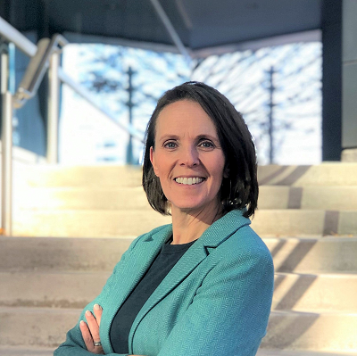
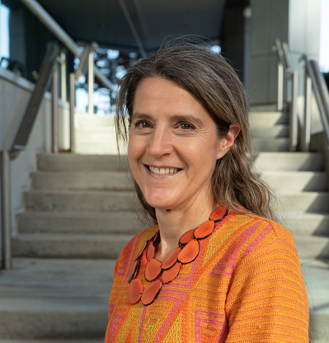
SHSP 2026-2030 Development Project Team
Janet Bahouth
Project Director
Becca Drayer
Program Manager
Rebecca Spicer
Data Scientist
Bekah Thomas
Workshop Moderator
Cara Lustik
Writer

Slide 6
Review of Relevant Work/Literature
Current and previous MD SHSPs
Safe System Approach literature
Other state SHSPs
GHSA’s Guidance for Developing Highway Safety Plans
Other
Projected Timeline: October 2024

Slide 7
Create 2026-2030 SHSP Development Plan and Hold Kickoff Meeting
Hold Kickoff Meeting to present plan to Executive Committee for approval to include:
Outline of tasks
Timeline
Milestones
Budget and communication controls
Stakeholder outreach process
Projected Timeline: October 2024-November 2024

Slide 8
Stakeholder Engagement
One on One Interviews with key stakeholders (TBD by MHSO)
Draw stakeholders’ insight and feedback on the state of highway safety in Maryland including current and future safety priorities
Online Survey to larger stakeholder group (TBD by MHSO)
SHSP emphasis area goals
Proposed action steps
Identification of emerging issues
Ideas for evaluating SHSP progress
Thoughts on how to maintain the SHSP’s relevance throughout the 2026-2030 term
Projected Timeline: December 2024-February 2025

Slide 9
Obtain EATs’ SHSP Feedback and Contributions
Interviews with EAT Chairs
EAT Team Workshops (One full day in person one ½ day virtual)
SHSP emphasis area goals
Proposed action steps
Identification of emerging issues
Ideas for evaluating SHSP progress
Projected Timeline: December 2024-March 2025

Slide 10
Develop Draft of 2026-2030 MD SHSP
Compile feedback from interviews, surveys, and workshops
Work with writer and graphic designer to develop draft for MHSO review and feedback
Projected Timeline: April 2025-June 2025

Slide 11
Finalize Document
Incorporate feedback and edits from draft review
Submit to Executive Committee and MHSO for final approval
Projected Timeline: June 2025-July 2025

Slide 12
Oct 1 - Oct 31
Nov 1 - Nov 30
117 days
30 days
29 days
27 days
56 days
60 days
2024
2025
SHSP Development Timeline
Oct
Nov
Dec
2025
Feb
Mar
Apr
May
Jun
Jul
Literature Review
Today
Review Literature
SHSP Development Plan & Kickoff
Develop Plan
Stakeholder Engagement
Stakeholder Interviews and Survey
EA Feedback
EA Chair Interviews
Workshops
Develop Draft
Develop and Submit Draft
Finalize Document
117 days
Develop and Submit Final

Slide 13
Questions?
Becca Drayer
bdrayer@crashcoremd.org

Slide 14
Develop and Deliver “What is the SHSP?” Presentation (October 2024-December 2024)

