Slide 1
Pedestrian/bicycle/Speed/aggressive emphasis area Teams
Cynthia Spriggs
Motor Vehicle Administration’s Highway Safety Office
Pedestrian/Bicycle/Speed/Aggressive Program Manager

Slide 2
Speed/aggressive
Currently have about 80 members
Virtual meetings until 2022
Hybrid meetings started in 2023
Co-Chair position is open

Slide 3
Engineering
SHA presented information to the team:
Speed feedback signs
Automated Enforcement
Speed limits
Context Zones
Complete Streets Update
Notes:
The Office of Traffic and Safety has been working on the Maryland Speed Action Plan which is currently being finalized. In 2023, some of the actions should start to be implemented. I look forward to working alongside of their team.

Slide 4
Legislative
Sub-committee similar to PBEAT
PBEAT advocates joined
Shared thoughts
Notes:
The Office of Traffic and Safety has been working on the Maryland Speed Action Plan which is currently being finalized. In 2023, some of the actions should start to be implemented. I look forward to working alongside of their team.

Slide 5
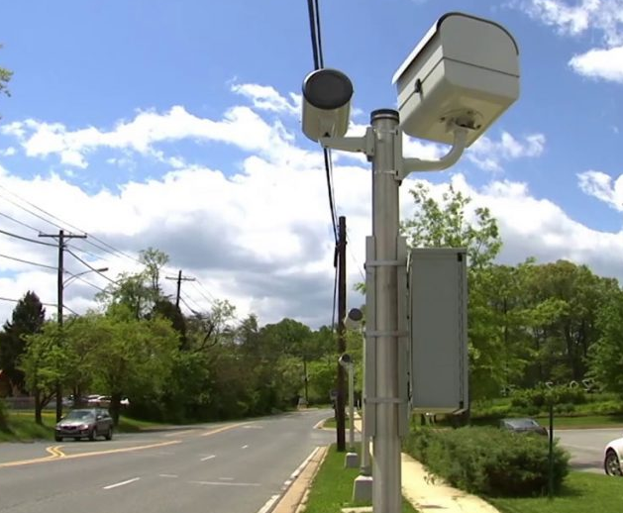
Enforcement - automated
Crash Core awarded mid-year FY23 and full FY24 grant to continue the study of automated enforcement.
Work Zones, School Zones, Residential and I-83
Notes:
With officer-initiated law enforcement down, we see a need to find new ways to enforce speeds. Even though automated enforcement is not new, there are jurisdictions expanding the program beyond school and work zones. In a little bit, you will hear from Crash Core on their findings of the Speed Camera Evaluation Project.

Slide 6
PBEAT
Currently have about 120 members
Hybrid meeting in March and June
All meetings will be back in person.
Averaging 30 in person with robust discussions
Co-Chairs, Joe Mogues and Kate Mazzaro
Ped/Bike Assessment Pedestrian & Bicycle Safety - Facts, Tips - Zero Deaths MD

Slide 7
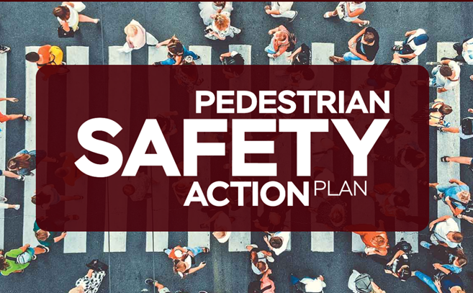
Pbeat – infrastructure
Improve roadway environments related to pedestrians and bicyclists by system-wide countermeasures, engineering treatments, and land-use planning.
Assessment Recommendation: Complete the Pedestrian Safety Action Plan (PSAP) that is currently in development and either include bicyclist safety measures in this plan or develop a Bicyclist Safety Action Plan
PSAP is completed and includes bicyclist safety measures.

Slide 8
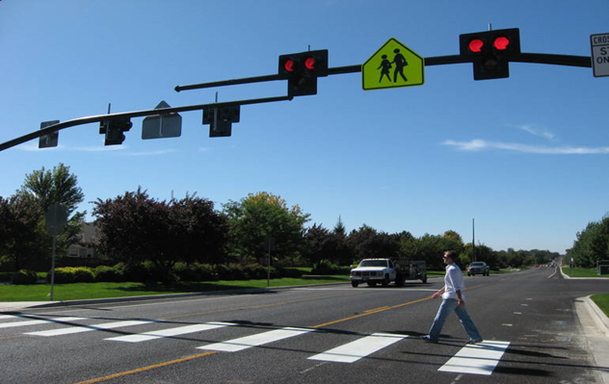
Infrastructure
VRU Assessment
Completed and added to the SHSP
HAWK Signals
PBEAT discussed HAWK signals and the need for education to drivers, cyclist and pedestrians

Slide 9
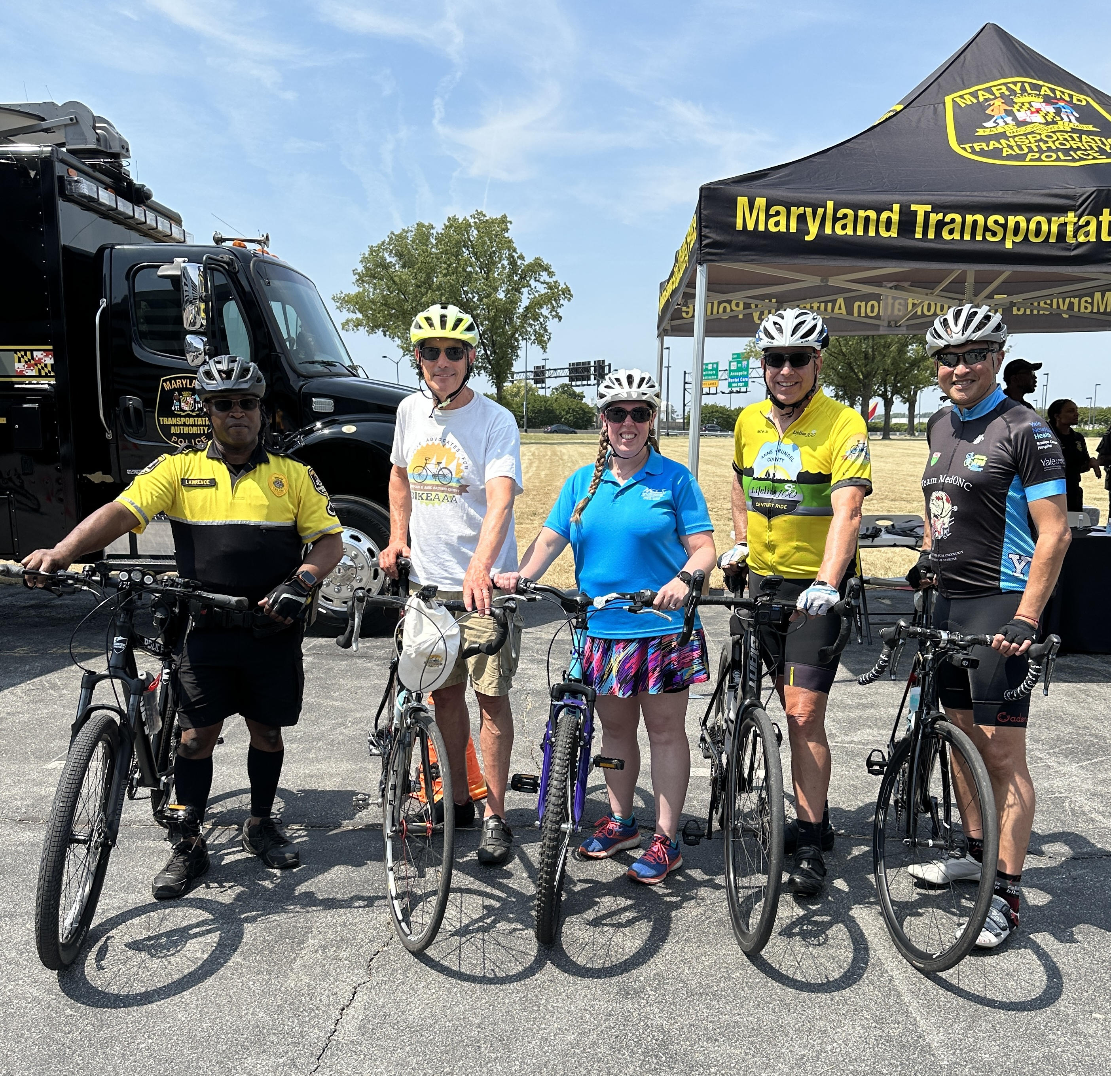
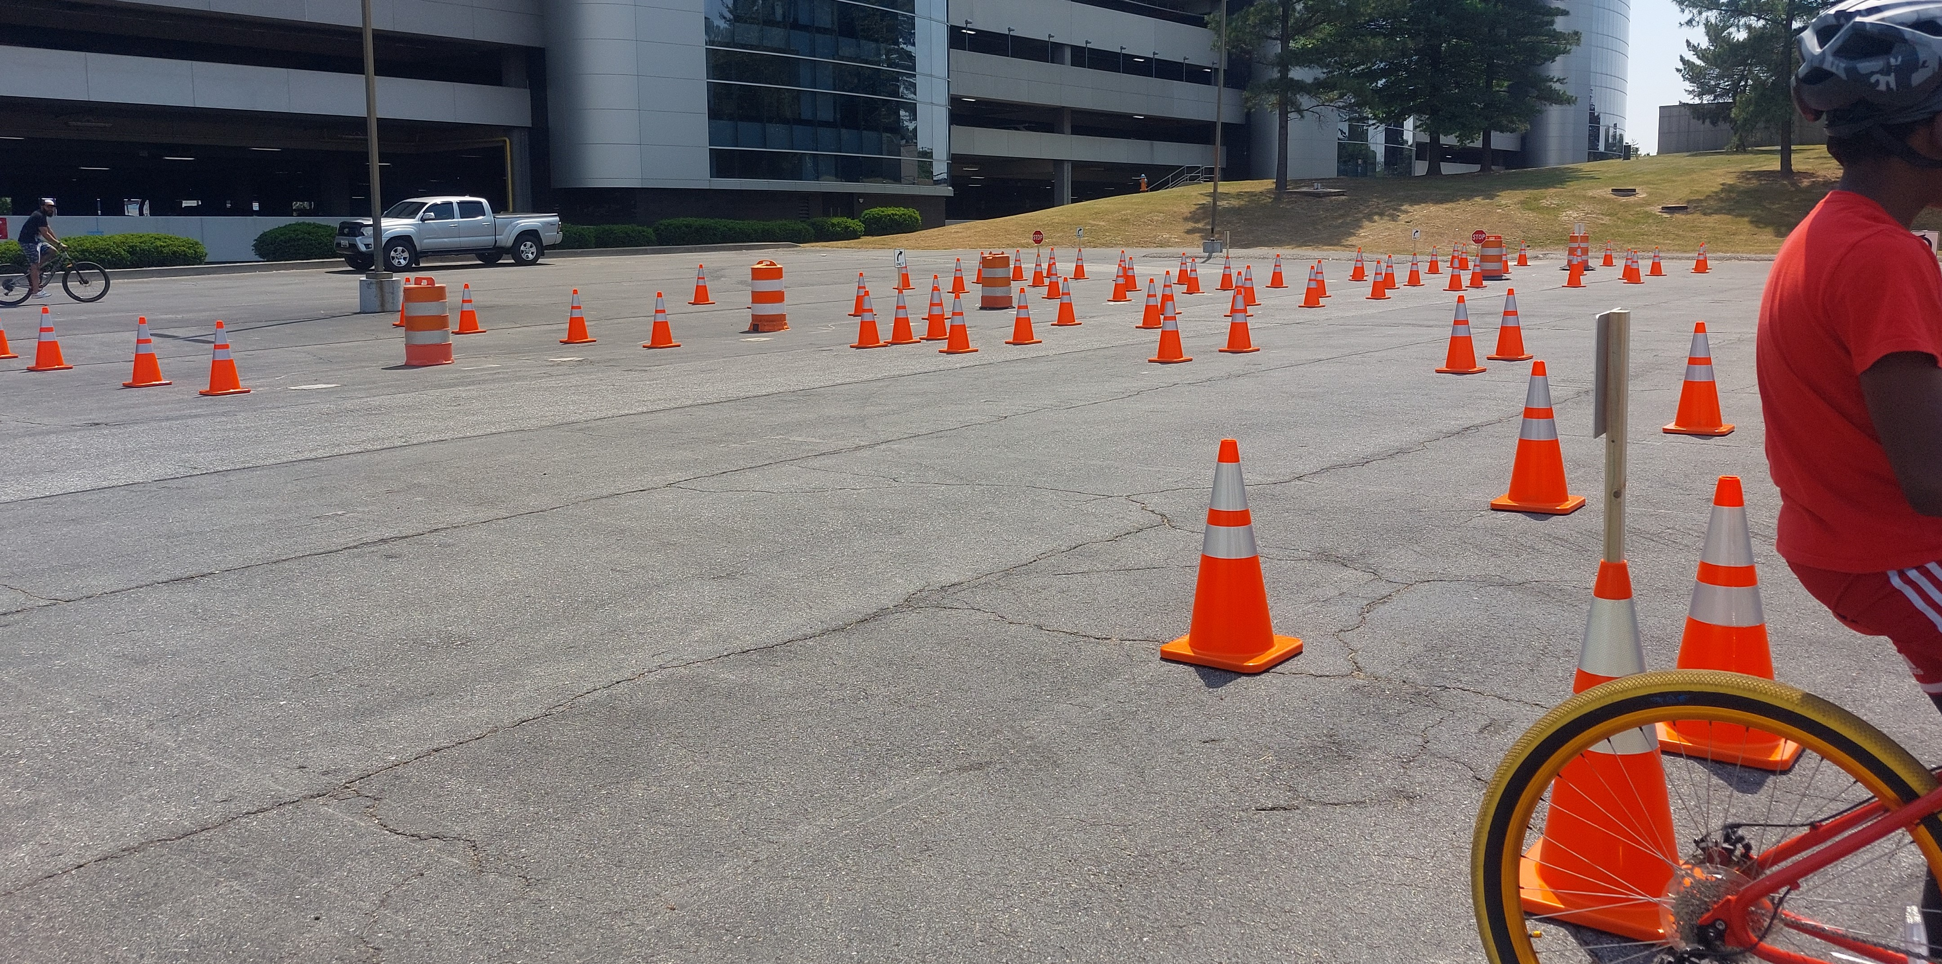
Pbeat - enforcement
Partnering with MdTA for Bike with a Cop
Teaching all ages but focus on young children.
Cone course to test skills and a 6-mile bike ride.
Training on enforcement – best management practices
The Baltimore County Police Department continues to host a Pedestrian Enforcement Seminar.
Notes:
Outreach with MdTA; Another training is scheduled for August for Baltimore County. I have it on my calendar and hopeful they will have enough officer willing to attend.

Slide 10
Pbeat - Outreach
Action Step # 2
Update course materials and curriculum for obtaining and renewing a driver's license in Maryland to better incorporate pedestrian and bicyclist safety and improve opportunities for additional education.
Assessment Recommendation: Promote driver education outside of the driver handbook, list the available classes on the MVA’s Highway Safety Office website for easy access, and promote driver education in all high school and college-based programs
We have established a working group.
Notes:
Discuss information pertaining to new drivers and outreach to all drivers. Collaborative group from state agencies, local government and advocates.

Slide 11
Pbeat – legislation
Action Step # 1 - "Legislation and Policy Action Items:
Establish a Pedestrian Bicycle Safety Legislative Task Force to serve as an on-going working group
Identify gaps in legislation and policy
Gather data and material to support the advancement of legislation and policy
Coordinate with work developed by the Maryland Bicycle Safety Task Force, Maryland Bicycle Pedestrian Advisory Committee, Bike Maryland, and other pedestrian and bicycle advocacy groups.
Notes:
Group continues to meet yearly and follow legislative process in session.

Slide 12
Thank you!
Cynthia Spriggs, Pedestrian and Bicycle Safety Program Manager
Motor Vehicle Administration’s
Highway Safety Office
cspriggs@mdot.Maryland.gov
410-787-4075

