Slide 1
Occupant protection and distracted driving EAT update
Mark J. Wall Maryland Highway Safety

Slide 2
Distracted driving data
In 2022 there were 51,032 distracted driving-related crashes. Out of those crashes, 21,225 people were injured and 199 were killed. ​

Slide 3
OP Driver & Passenger fatalities

Slide 4
CIOT & Distracted Driving awareness month
Enforcement & Media 5/13 - 6/2
Seatbelt surveys 6/3 – 6/17
Rollover Sim Bowie St. 4/24
Rollover Sim MDTA 5/22
5 High School Mock Crashes
2 High School Distracted Driving Programs

Slide 5
Low Seatbelt concerns
Caroline Co. 76.1%
Washington Co. 81.7%
Charles Co. 88.6%
Baltimore Co. 89.7%
Trucks 89.0%
Local Roads 81.3%

Slide 6
Implementation of electronic data collection
Each data collection team (DCT) will be equipped with an iPad for surveys. The FormConnectPro app will be used to collect seatbelt usage on Maryland's roads.

Slide 7
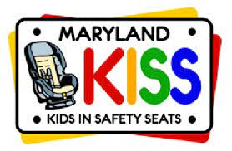
CPS Updates
18 New CPST’s in quarter 1
384 Car or booster seats distributed to families.
6 CPST Classes remaining

Slide 8
CPS Alert!
NCPSB Webinar: Car Seat Detective
Non Compliant or Counterfeit Car Seats
Sold at a significantly lower price

Slide 9
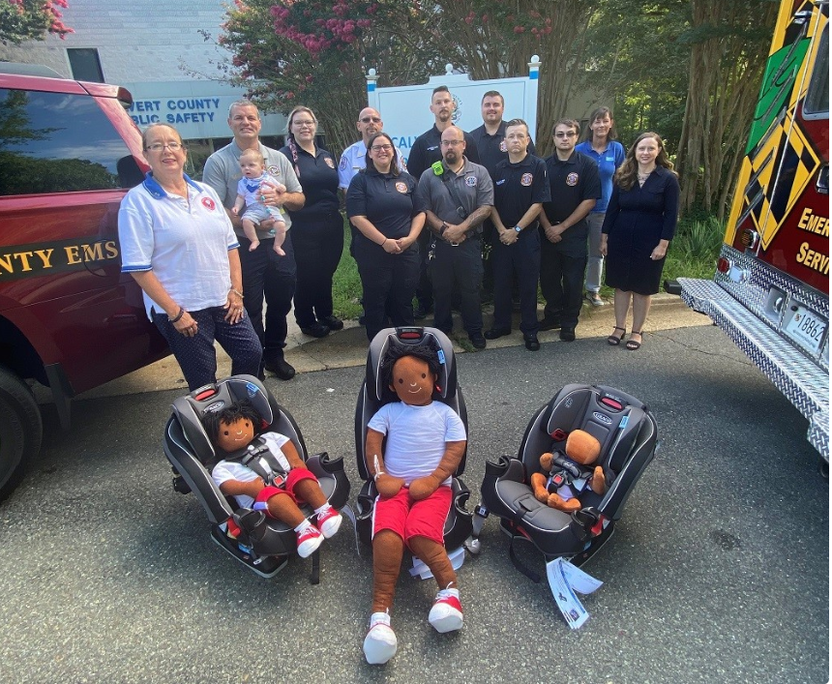
Fire & EMS Expansion and Pilot Project
12 agencies
38 donated seats
54+ Emergency Responders trained
Notes:
After a successful partnership with law enforcement….expanded to EMS, etc.
Maryland Institute of Emergency Medical System Services (MIEMSS) encouraged EMS departments agencies to apply.
Agencies would receive Graco “Slim Fit” All-in-one car seat to use in a supervisor’s vehicle for transporting children who do not require ambulance transport.
Pilot project include in-person, print and video instructions for how to use and install the car seat.

Slide 10
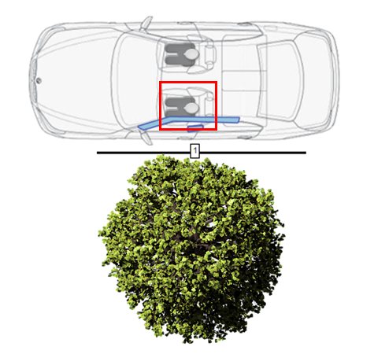
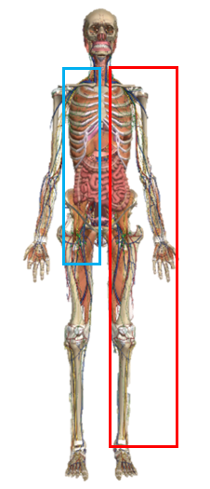
Enhanced EMS OP Trainings
Training developed to improve data collection and accurate documentation of a crash in eMeds (Electronic Maryland EMS Data System).
Clinicians will improve emergency treatment plans and transport decisions from an enhanced knowledge and anticipation of injuries based on what they observe at a crash scene.
Notes:
in the last five years, the rate of missing data in the “safety equipment use” field has increased from 5.1% in 2017 to 14.5% in 2022. The rate of missing data in the “location of patient” field has increased from 12.3% in 2017 to 15.6% in 2022.
Maryland Institute of Emergency Medical System Services (MIEMSS) has expanded the initial project training, and collaborated with crash core to develop crash science training for first responders. This training educates on the implications of a crash scene (what happened and how) and, occupant ramifications based on damage (front, side, rear, rollover). Identification of use/non-use of a restraint/car sear and how these factors contribute to injury, not only improves accuracy in documentation decreasing the rate of unknown or missing safety equipment use, it also improves emergency treatment plan and transport decisions.

Slide 11
Questions?
Mark J. Wall,
Occupant Protection and Distracted Driving Program Manager
Maryland Department of Transportation
Motor Vehicle Administration’s
Highway Safety Office
mwall1@mdot.maryland gov
410-787-4096

