Slide 1
Impaired driving eat update
Cliff Jacobs
Impaired Driving Prevention Program Manager

Slide 2
Impaired driving: data
Data: Use the collection, analysis, and evaluation of data to identify impaired by alcohol or drugged driving emphasis area issues.
Key Target: Reduce the number of alcohol/drug impaired driving related fatalities on all Maryland roads from the five-year average (2005-2009) of 202 to 127 or fewer by December 31, 2025.
Over the past five years in Maryland, nearly 800 people have been killed in crashes Involving an impaired driver

Slide 3
Impaired driving: enforcement
Enforcement - Support the enforcement of laws pertaining to the impaired by alcohol and drugged driving emphasis area.
Enforcement initiatives & High-level activities
Holiday Enforcement- St. Patrick’s Day, Cinco De Mayo, and the 4th of July
Statewide and SPIDRE Enforcement
National Mobilization- August 2024
Impaired Driving Assessment- Completed September 2023
Training
DRE- Drug Recognition Expert
ARIDE- Advanced Roadside Impairment Driving Enforcement
GHSA & Responsibility.org- MHSO was awarded a grant to fund four (4) Cannabis Impairment Labs “Green Labs” and implement ARIDE classes.
Notes:
Emphasize the Training aspect and 2-3 IDA recommendations.

Slide 4
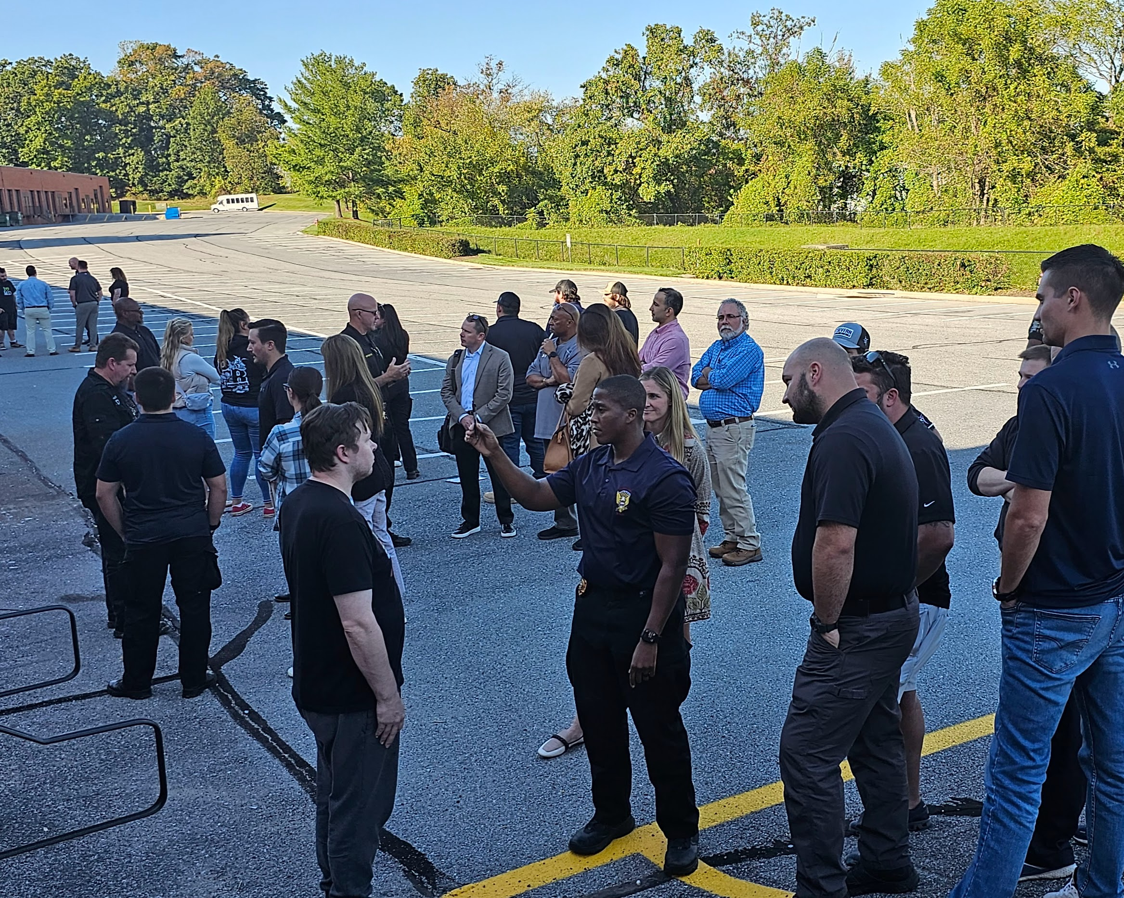
Impaired driving: enforcement training
Notes:
Green lab examples of officers conducting SFST’s.

Slide 5
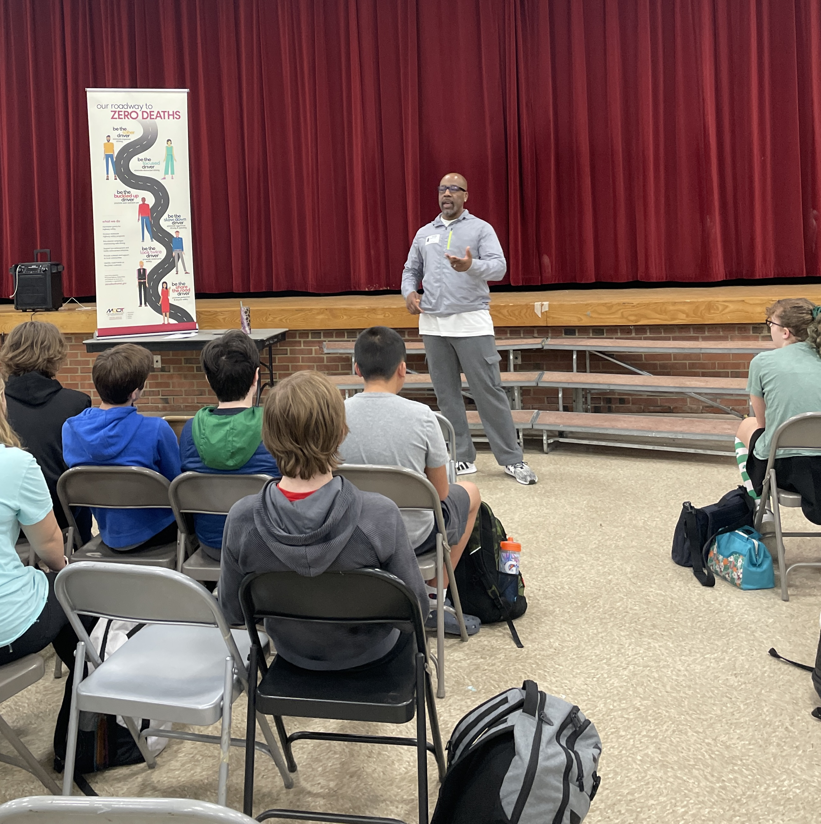
Community engagement
Community Engagement: Promote a safety culture by promoting initiatives including:
Public awareness
Education
Training
Media Campaigns- Be the Driver
Notes:
Recently at Central Middle School to present to students on the dangers and consequences of underage drinking and impaired driving.

Slide 6
Community engagement
Notes:
Discuss work with Bowie State. Working with BSU ATOD (Alcohol, Tobacco, and Other Drugs) on an MHSO mid-year grant. Visited campus several times to meet with students and faculty. Will be on campus April 24th for Yard Fest. Development of a Be the Driver HBCU edition. Assisting students with the Be The Driver # plan D (D stands Designated).
U.S. Army. December 2023 3D Event (virtual) Impaired Driving Discussion and prevention to an audience of 200 soldiers. Will return to Ft. Meade in April for Alcohol Awareness Month. Will engagement over 200 soldiers in interactive games to emphasize the effects of impairment.

Slide 7
Impaired driving
MHSO was awarded a $20,000 GHSA Holiday Impaired Driving Grant powered by Lyft. Ride credit codes were shared on social media.
The program provided resources to help MHSO conduct campaigns during the 2023 holiday season encouraging people to make the responsible decision and leave the driving to someone who is sober.
MHSO applied for FFY24 GHSA/ R.org Grant. Included new initiatives (DUI Courts, Green Lab w/ Minority Community, HBCU’s)
Notes:
Highlight the FFY24 GHSA/ R.org grant submission and initiatives.

Slide 8
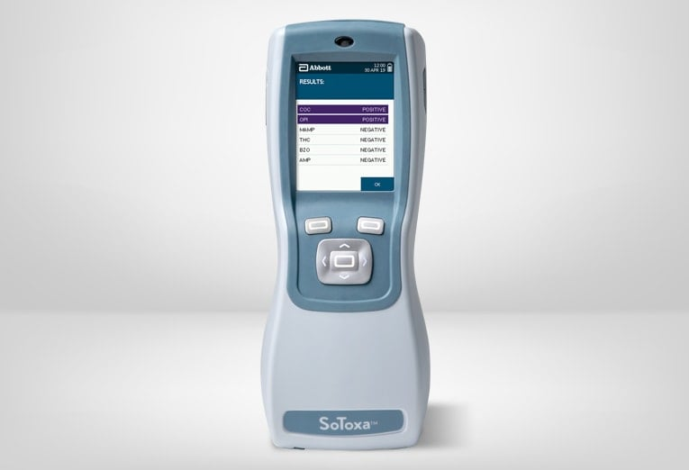
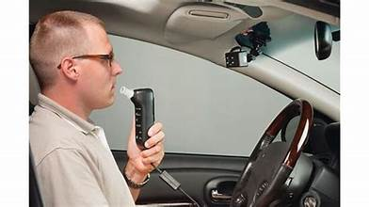
Impaired driving: vehicle engineering technologies
Ignition Interlock
31.3 % of drivers are either strongly or slightly opposed requiring all new cars to have built in technology that won’t let the car start if the driver’s BAC is over the legal limit.
Oral fluid testing devices

Slide 9
Impaired Driving: Infrastructure
Improve roadway environments and support systemwide countermeasures engineering treatments, and planning.
Increase signage on roadways announcing DUI enforcement areas
Coordinating other activities to increase the visibility of DUI activities.

Slide 10
IMPAIRED DRIVING: LEGISLATION
Bipartisan Infrastructure Legislation (BIL)
Includes the Safe Streets and Road for All program to reduce traffic fatalities.
Grants awarded to State’s with Ignition Interlock laws.
Impaired Driving Countermeasures: Awarding grants to State’s that adopt and implement effective program to reduce traffic safety problems resulting from individuals driving under the influence of alcohol, drugs, or both.

Slide 11
IMPAIRED DRIVING: LEGISLATION
Improve the safety culture of Maryland through the support of legislation and adjudication efforts.
DUI Institute for Prosecutors: Organized by the Traffic Safety Resource Prosecutor (TSRP). April 23-26 at the University of Maryland, College Park.
Judicial training/ SJOL (State Judicial Outreach Liaison)- active or retired judges who function as subject matter experts to share the latest research and best practices on addressing impaired driving and recidivism in their respective state.

Slide 12
Impaired driving

Slide 13
Questions?
Cliff Jacobs, Impaired Driving Prevention Program Manager
Maryland Department of Transportation
Motor Vehicle Administration
Highway Safety Office
cjacobs1@mdot.Maryland.gov
410-787-4078

