Slide 1
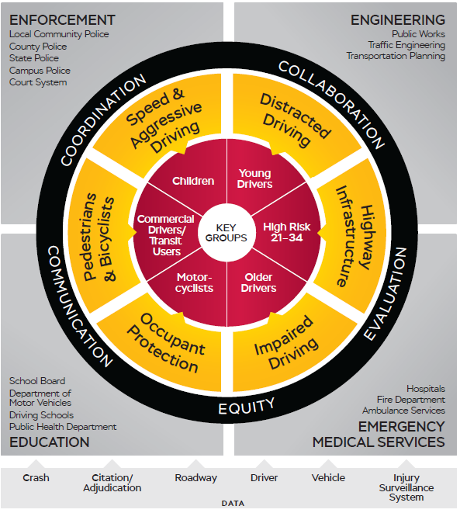
The Maryland Department of Transportation Motor Vehicle Administration Maryland Highway Safety Office (MHSO)
Traffic Records Data Update Highlights
SHSP Meeting, March 22, 2024
Rev. March 19, 2024
Version February 2022

Slide 2
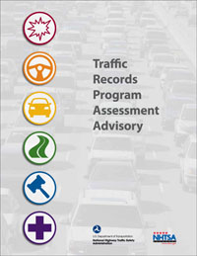
Assessment/TRSP
Traffic Records Coordinating Committee (TRCC)
Last Assessment: 2019.
Upcoming Assessment: June – September 2024.
2025: Traffic Records Strategic Plan (TRSP)
Concurrent with SHSP > 2026-2030.
Notes:
State’s data improvement program guided by the TRCC.
5-year plan runs concurrent with the SHSP.
Every 5 years we conduct an Assessment facilitated by NHTSA involving subject matter experts from around the country.
They evaluate crash, citation and adjudication, driver and vehicle, roadway, and hospital and EMS data systems.
In 2025 we will update the TRSP in a similar manner and timeline as the SHSP.

Slide 3
Maryland Traffic Records Coordinating Committee
MDOT MVA Administrator, Governor’s Representative for Highway Safety (Chrissy Nizer)
TRCC Executive Council
Tri-Agency Council for Crash Data Management
TRCC Technical Council
SHSP Executive Council
Emphasis Area Teams
Crash Data Management Advisory Subcommittee
Crash Data Accessibility Subcommittee
Data Strategy Leads
Other Subcommittees Task Forces (As Needed)
Notes:
Chrissy Nizer is the Governor’s Representative for Highway Safety and is the Chair for the TRCC and SHSP Executive Councils.
In the SHSP, for each EAT and the strategies and action steps, the leads are members or are connected to the TRCC.
The TRCC has in large part been focused on SHSP data needs (accessibility, like online dashboards).
We’ve been doing more work with local strategic planning groups that are publishing data online.

Slide 4
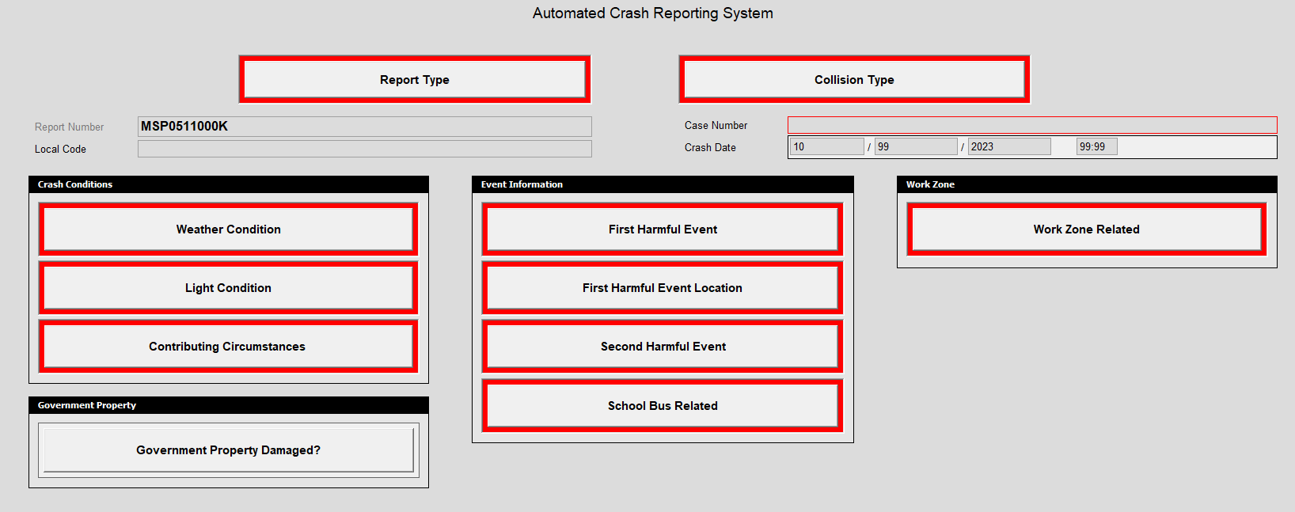
SEDC
State Electronic Data Collection (SEDC).
Applications due May 15.
Awards expected by December 2024.
Upgrade/improve crash data collection and accessibility (ACRS).
Notes:
Earlier this NHTSA announced a 350 million opportunity for states to improve their crash data systems.
MHSO will be applying and is working with MSP on an application due on May 15.
Will focus on upgrading to MMUCC 6, recently launched by NHTSA. And data integration with a focus on data quality, integrating with other datasets to reduce the burden on officer data collection.
Will have 5 years to implement.

Slide 5
ACRS 2.0
Notes:
ACRS 2.0 was launched by MSP on January 1.
Most significant change to crash report in decades and major changes since ACRS was launched in 2015.
Improvements in locations (integration with SHA roadway file; roadways updated quarterly). Interface requires officer to select a location in the inventory.
More discrete codes like non-motorist types for scooters (feedback from EATs considered and included in ACRS 2).

Slide 6
Crash Data workflow
ACRS
Automated Crash Reporting System
Prod.
MDSP Production Database
DW
MDSP Data Warehouse (ETL)
Auth. Access.
DW Authorized Users
Public Download
Tableau Crash Data Download Tool
MDOT SHA
TANG/MSCAN
Fatal Dashboard
Zero Deaths Fatal Crash Dashboard
CRD
Central Records Division
RAVEN
Washington College
AA VZ
Anne Arundel County Vision Zero Dashboard
BMC
Baltimore Metropolitan Council Dashboards
Note: The Public Download dashboard examples are only a sample. This is not an exhaustive list of applications using the MSP public download crash data.
Notes:
Briefly shows how the data from officer reporting to the MDSP and to authorized users.
Authorized users ideally are getting access to the Data Warehouse.
All others are accessing the Tableau Public Download Tool.
Which is the source for a growing number of public-facing dashboards, which will soon include an upgrade of RAVEN.
This has involved a lot of work for agencies transitioning from using the annual SHA version of crash data to now a daily feed of crashes in a different format from MSP.

Slide 7
Fatal Crash Dashboard
https://zerodeathsmd.gov/resources/crashdata/crashdashboard/
Launched April 12, 2023
Maryland Highway Safety Summit.
Relaunched March 13, 2024 > ACRS 2.0.
Source: MDSP Data Warehouse (ACRS).
Platform: Tableau.
Updated every morning.
Years available: 2016 to current.
Includes open reports/ open investigations.
No personally identifiable information (PII).
Notes:
Launched last year at the Summit and relaunched recently (last week) to include 2024 fatal crashes.
We’re still working on some of the features/visualizations and data definition updates are forthcoming.
The benefit of this application (compared to the public download) is that is displays counts of crash reports that are still open for investigation.

Slide 8
Fatal crash dashboard
Definitions FAQs Demo Video
Notes:
Please review the supplemental materials on the ZeroDeaths website to learn more about the data available in the dashboard.
We receive a lot of inquiries about the dashboard and also the public download tool.
There really could be more supporting documents, and the data can be overwhelming for those who do not work with it regularly, especially the general public.
This is why we have the Crash Data Accessibility TRCC Subcommittee, to advise on ways to improve how data are presented publicly and to create standards across crash data analysis applications.

Slide 9
Fatal crash dashboard
Notes:
The dashboard is limited to fatal crashes only and it is updated every morning.
Because there are preliminary reports, there will be incomplete information (“not yet reported”).
MSP FARS Analyst sign-off. NHTSA FARS just closed 2022 (3/15).

Slide 10
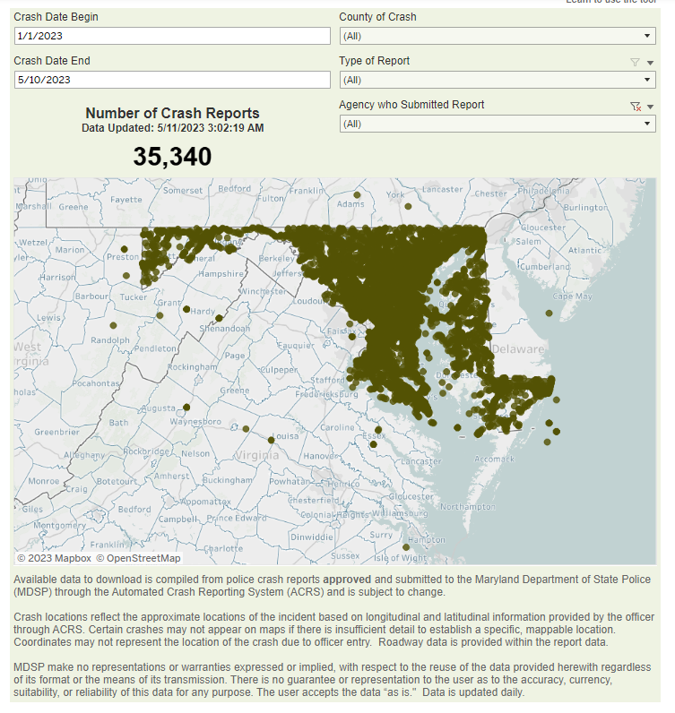
MDSP Crash data Download
https://mdsp.maryland.gov/Pages/Dashboards/CrashDataDownload.aspx
Years available:
2019 – year-to-date.
Data subject to, and will, change.
Officer report updates; record updates.
Updated every morning.
Only approved reports.
2024 (ACRS 2.0) under review (availability TBD).
Notes:
Crash data download tool launched May of last year.
MSP looking at improving the interface and features based on who is using the data.
2024 is still being reviewed and processed. Availability is TBD.
Years earlier than 2019 (back to 2015) under consideration as static file downloads (“closed” years).

Slide 11
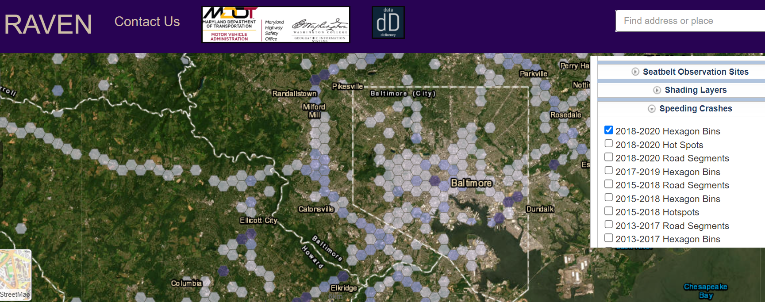
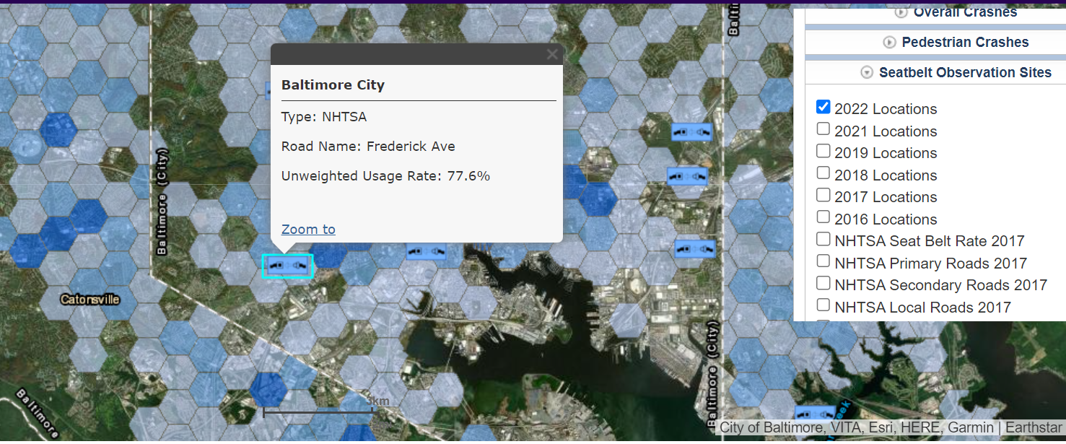
RAVen (2016-2024)
Notes:
Lastly, the current RAVEN application launched in 2016 is reaching its end-of-life cycle. In fact, it is beyond that now and some functionality has ceased.
A new application is being developed by Washington College and we are scheduling demos and seeking feedback.

Slide 12
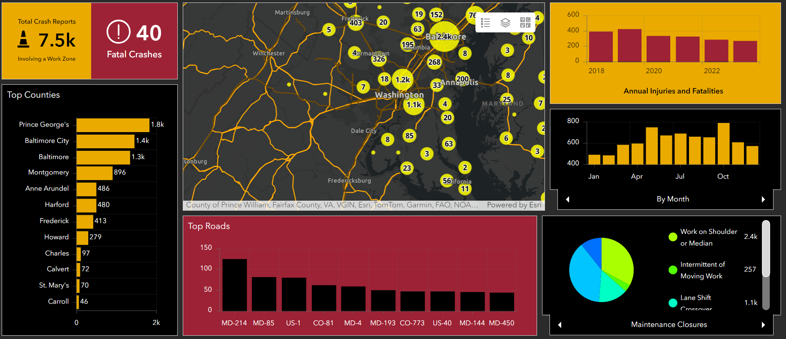
RAVEN 2.0
Notes:
The new RAVEN will launch at the May Summit.
It will be embedded in ZeroDeathsMD.gov and the dashboards/visualizations will be public-facing.
Some features will remain private (there is no PII, but analysis features too complicated for the public will be accessible by authorized users).

Slide 13
Questions?
Doug Mowbray (he/him)
Traffic Records Program Manager
Maryland Department of Transportation
Motor Vehicle Administration
Highway Safety Office
dmowbray@mdot.maryland gov
410-424-3668

